Slide 1
WTF is MVC?
Daniel Hyres
#100Devs
August 23rd, 2022

Slide 2
MVC, what is it?
Master Volume Control ?
Multi-Variable-Calculus?
Moreno Valley College?
Mountain View College?
Male Voice Choir?
Motor Vehicle Commision?
Mean/Variance/Covariance?
Mid-Cap-Value?
Music Video Channel?
I could keep going, but…
Nope! It’s none of these.

Slide 3
MVC, what is it?
MVC is an architectural paradigm for PROGRAMMING!!!
MVC stands for => Model-View-Controller
It is a way of structuring web applications
It is NOT a framework
It is USED by many existing frameworks available and in use today
Express, Ruby on Rails, Laravel, Angular, Flask, etc, etc, etc, etc.
Designed in the late 70’s
A different time in history

Slide 4
Ok…but what does that mean?
“Architectural paradigm”:
A way of consistently setting up projects such that developers can quickly understand and navigate the folder and file structure to find a particular aspect of the code
Instead of having everything in one large and confusing file, it is broken up into separate more manageable pieces!

Slide 5
Ok…but what does that mean…in ENGLISH?
“Architectural paradigm”:
Basically a way of describing the file structure AND what should be in each file
It is how the project is ORGANIZED into different files and folders

Slide 6
Ok…starting to make a bit of sense…
GREAT! Let’s go a bit deeper into what each role of the MVC acronym represents
MODEL - VIEW - CONTROLLER

Slide 7
MODEL - VIEW - CONTROLLER
MODEL:
The ‘MODEL’ component of the MVC architecture represents anything that interacts with your you data, i.e, your DATABASE
The ‘Model’, or Model files, are responsible for actions such as:
Adding and retrieving items from a Database (either to or from the database)
Processing data to or from the database
It is connected to the DB and pulls info from the DB
It only speaks with the Controller (we’ll get to that one)

Slide 8
MODEL - VIEW - CONTROLLER
MODEL:
Remember: MODEL => Database
Pro-gamer tip for remembering:
Model starts with the letter ‘M’, just like the popular database program MongoDB

Slide 9
MODEL - VIEW - CONTROLLER
VIEW:
The ‘VIEW’ component of the MVC architecture represents anything that the CLIENT/USER will see. It is related to the FRONT-END
The ‘View’, or View files, are essentially what:
Displays info to the USER, usually via a templating language
It is the only thing the USER ever sees
The Controller and Model are all ‘behind the scenes’
Can be thought of as good old fashioned HTML/CSS
LISTENS to the CONTROLLER but does not interact with the Model
Remember, the MODEL is related to the Database

Slide 10
MODEL - VIEW - CONTROLLER
VIEW:
Remember: VIEW => Client/User-side
Pro-gamer tip for remembering:
Ask yourself- Where are things VIEWED, and by whom? (Client!)

Slide 11
MODEL - VIEW - CONTROLLER
CONTROLLER:
The ‘CONTROLLER’ component of the MVC architecture represents anything that relates to the SERVER
The ‘Controller’, or Controller files, are essentially what:
Process requests, i.e. CRUD requests
POST/GET/PUT/DELETE
Consists of all SERVER-SIDE logic
SPEAKS to the VIEW to explain presentation to the viewer
Processes info and talks to the DB (MODEL) if needed
Is BETWEEN the Model (DB) & View (Front-end)
The Middleman!

Slide 12
MODEL - VIEW - CONTROLLER
CONTROLLER:
Remember: CONTROLLER => Server
Pro-gamer tip for remembering:
Remember the other two and infer what the Controller is for

Slide 13
MODEL - VIEW - CONTROLLER
All Together Now:
Model => Database
View => Client/User-Side
Controller => Server

Slide 14
MODEL - VIEW - CONTROLLER
Another way to think of it:
If you are writing code that is related to the Database: it goes in the Model
If If you are writing code that outputs Front-End visible content: then it’s View
If you are writing code that relates to the Server: that’s the Controller

Slide 15
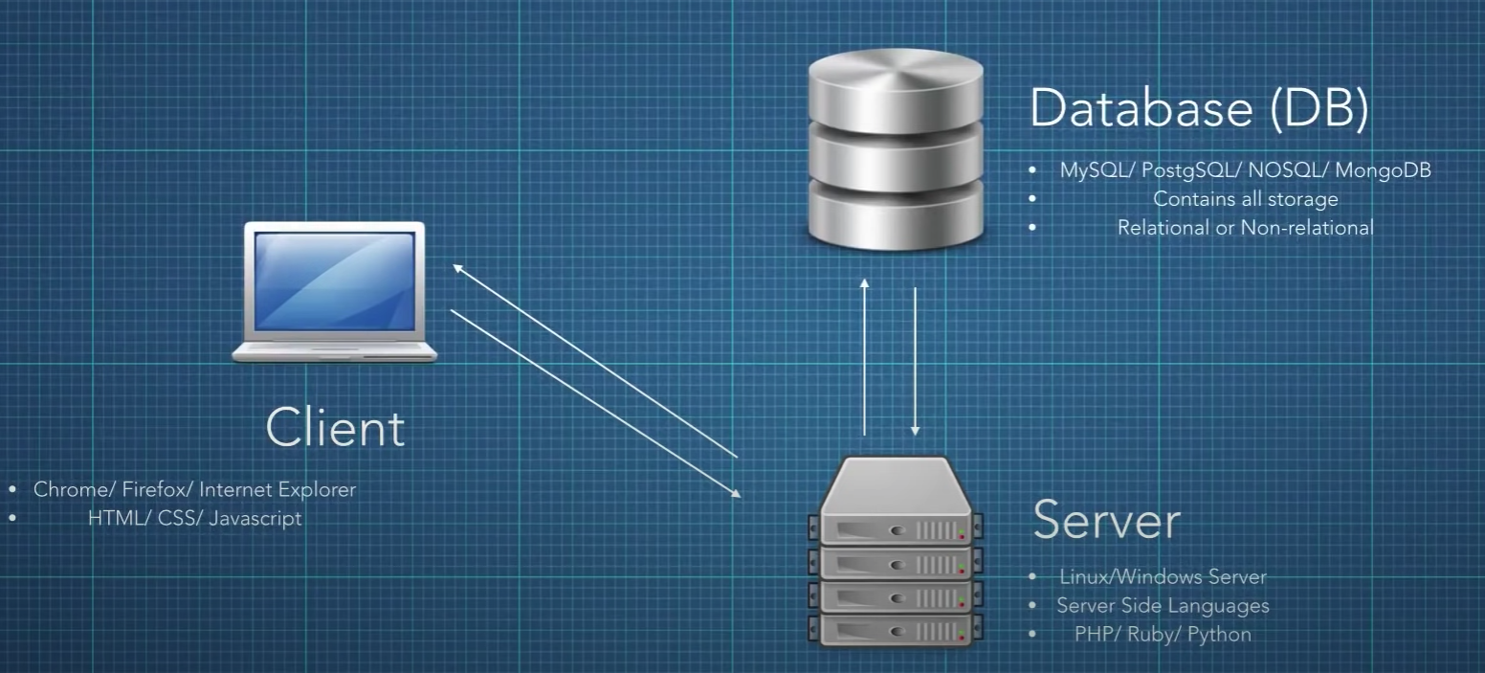
MODEL - VIEW - CONTROLLER
Helpful Diagram courtesy of DevMarketer

Slide 16
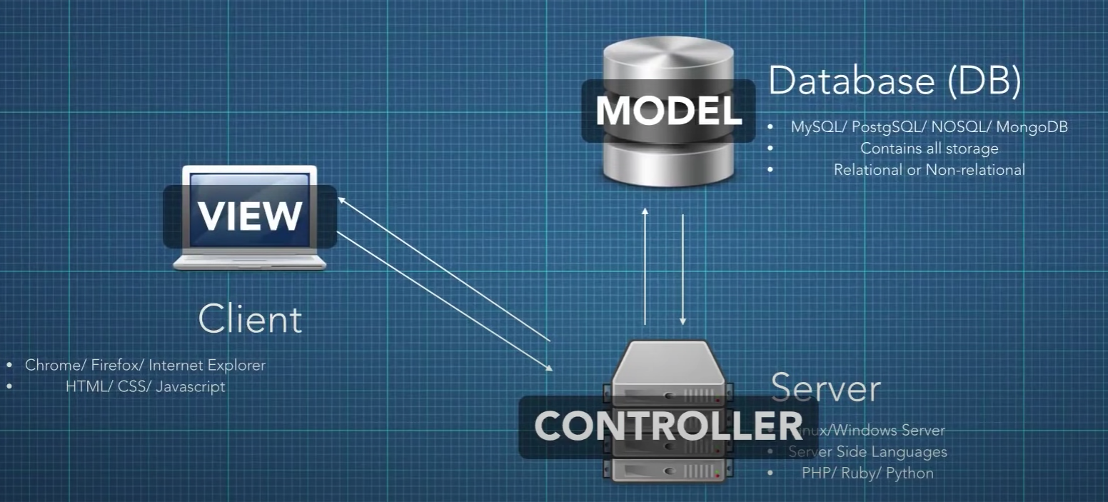
MODEL - VIEW - CONTROLLER
Helpful Diagram courtesy of DevMarketer

Slide 17
So…what are the benefits of using MVC?
Organization - easy to find different aspects of the code
Group programming - different files allow for easier collaboration
Modularity - easy to swap out components
Reusability - easy to reuse and not have to ‘code from scratch’
Testing - easier to perform targeted testing if/when something goes wrong

Slide 18
Going Deeper #1
Routes/Routers:
Routes map URLS to specific controller functions
Routes are like ‘traffic directors’, directing each request to the proper controller file and method

Slide 19
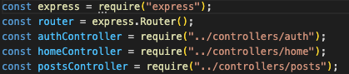
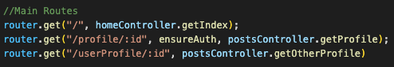
Going Deeper #1
Example: Route file ‘main.js’

Slide 20
Going Deeper #2
Mongoose/Schema’s:
Mongoose is an Object Data Modeling (ODM) library for MongoDB
Provides a way to ‘model’ data by way of a ‘schema’
Schema’s define the structure of a Mongo document
They are document data structure, akin to a template or blueprint for what goes into the database
Schema’s are typically what you would find in a ‘Model’ folder, per the MVC structure
Often multiple model files/schema’s for a project

Slide 21
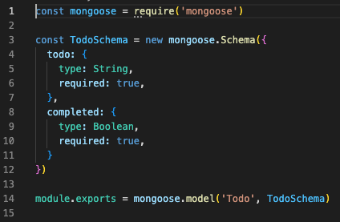
Going Deeper #2
Example: Model file & Mongoose Schema

Slide 22
Let’s recap!
MVC is an architectural paradigm for PROGRAMMING!!!
MVC stands for => Model-View-Controller
It is a way of structuring web applications
It is NOT a framework
It is USED by many existing frameworks available and in use today
Designed in the late 70’s

Slide 23
Let’s recap!
MODEL - VIEW - CONTROLLER
Model => Database
View => Client/User-Side
Controller => Server

Slide 24
Let’s recap!
MODEL - VIEW - CONTROLLER
If you are writing code that is related to the Database: it goes in the Model
If If you are writing code that outputs Front-End visible content: then it’s View
If you are writing code that relates to the Server: that’s the Controller

Slide 25
The End

